Slide 1
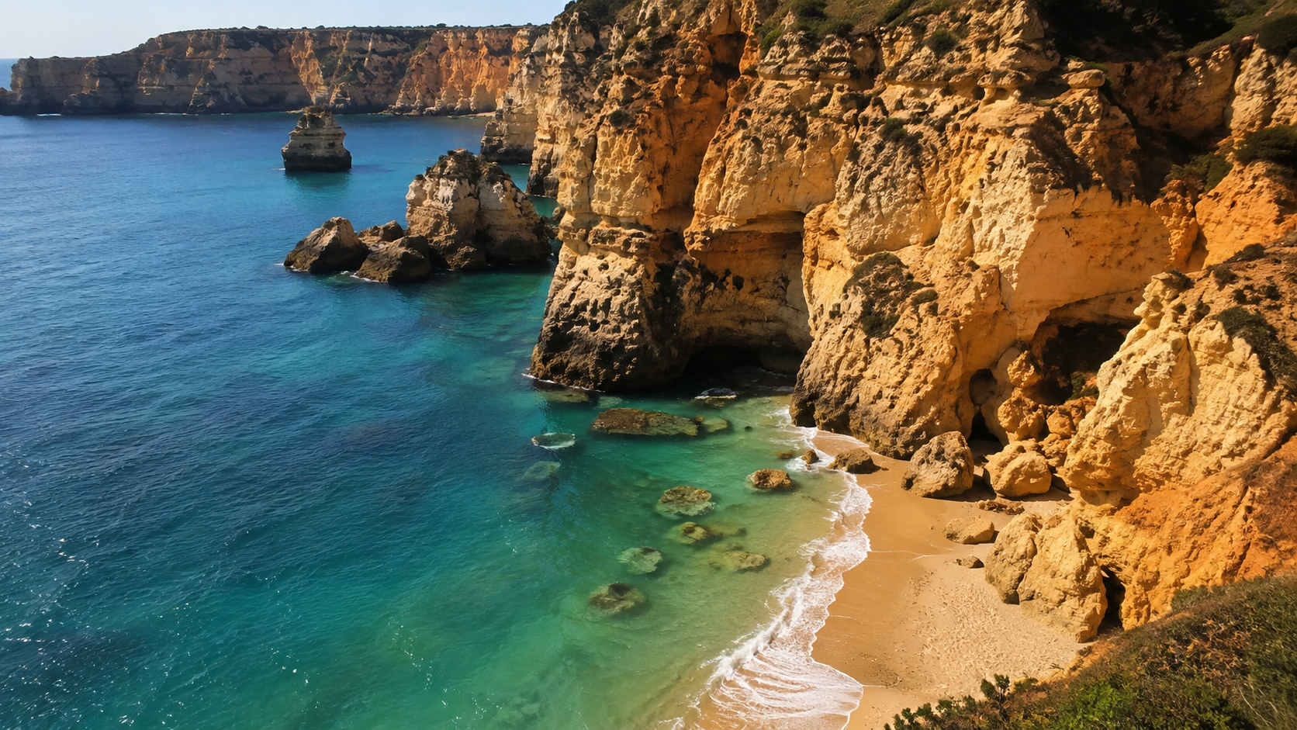
TRIP PLANNING · SUMMER 2026
Mediterranean Island Trip 2026
Five destinations, scored and compared — beaches, budgets, logistics, and when to go.

Slide 2
How we scored it
Every destination gets one to five stars on the five things that make or break a Mediterranean week.
Beach quality
Value for money
Getting there
Food & fun
Family ease
THE FIVE CONTENDERS
Sardinia
Mallorca
Corfu
Malta
Crete
ALSO CONSIDERED
Cyprus, Sicily and Menorca — trimmed for heat, scale or overlap.

Slide 3
OPTION 01 · ITALY
Sardinia
A beach-first road trip with spectacular coves and excellent food.
Beach quality
★★★★★
5
£3.8k
★★☆☆☆
est. 7 nights, couple, mid-range, incl. flights
Value for money
2.5
Getting there
★★★☆☆
3
Best beaches
Road-trip feel
Great food
Food & fun
★★★★☆
4
Car hire is close to essential, and peak-summer coastal stays are expensive.
Family ease
★★★★☆
4

Slide 4
OPTION 02 · SPAIN
Mallorca
The easiest all-rounder: beaches, Palma, mountains and plentiful direct flights.
Beach quality
★★★★☆
4.5
£2.8k
★★★★☆
est. 7 nights, couple, mid-range, incl. flights
Value for money
4.5
Getting there
★★★★☆
4.5
Direct flights
Broad choice
Beach + city
Food & fun
★★★★☆
4.5
Popular resorts get crowded in July–August; quieter coves often require a car.
Family ease
★★★★☆
4.5

Slide 5
OPTION 03 · GREECE
Corfu
A compact, green island with relaxed beaches, tavernas and an easy old-town base.
Beach quality
★★★★☆
4
£2.2k
★★★★★
est. 7 nights, couple, mid-range, incl. flights
Value for money
5
Getting there
★★★★☆
4
Budget winner
Compact island
Old-town charm
Food & fun
★★★★☆
3.5
Beach quality is strong rather than exceptional, and nightlife varies sharply by resort.
Family ease
★★★★☆
4.5

Slide 6
OPTION 04 · MALTA
Malta
The easiest culture-and-coast option, with excellent transport and plenty beyond the beach.
Beach quality
★★★★☆
3.5
£2.6k
★★★★☆
est. 7 nights, couple, mid-range, incl. flights
Value for money
3.5
Getting there
★★★★★
5
Easy logistics
Food scene
History + sea
Food & fun
★★★★☆
4.5
Fewer classic sandy beaches than the Greek, Spanish and Italian options.
Family ease
★★★★☆
4

Slide 7
OPTION 05 · GREECE
Crete
Big-island variety: strong beaches, food, history and enough depth for a full week.
Beach quality
★★★★☆
4.5
£3.1k
★★★★☆
est. 7 nights, couple, mid-range, incl. flights
Value for money
4
Getting there
★★★★☆
3.5
Beach variety
Food + culture
Good value
Food & fun
★★★★☆
4
Distances are long; trying to cover too much of the island weakens the trip.
Family ease
★★★★☆
4

Slide 8
Head to head
All five contenders, all five criteria — gold is good.
Beach quality
Value for money
Getting there
Food & fun
Family ease
Sardinia
5
2.5
3
4
4
£3.8k
Mallorca
4.5
4.5
4.5
4.5
4.5
£2.8k
Corfu
4
5
4
3.5
4.5
£2.2k
Malta
3.5
3.5
5
4.5
4
£2.6k
Crete
4.5
4
3.5
4
4
£3.1k

Slide 9
What a week really costs
Estimated all-in cost — 7 nights, two people, mid-range.
Sardinia
£3.8k
Crete
£3.1k
Mallorca
£2.8k
Malta
£2.6k
Corfu
£2.2k
2x spread
Sardinia costs roughly twice a Corfu week.

Slide 10
When to go — and what to dodge
Mediterranean summer is mostly a trade-off between heat, crowds and price.
JUNE
JULY–AUG
SEPT
BOOK IT
PEAK EVERYTHING
SHOULDER GOLD
Warm seas, long days and lower prices before school-holiday peaks.
Hottest weather, busiest beaches and the highest accommodation rates.
Warm water remains, while crowds and hotel rates generally ease.
Crowds: MEDIUM
Crowds: PEAK
Crowds: LOWER
Mallorca & Corfu: strongest for easy one-week trips
Sardinia: best if you are happy to drive
Crete: avoid over-planning long cross-island days

Slide 11
Where the stars point
The verdict
BEST OVERALL
BEST SPLURGE
BEST VALUE
Mallorca
Sardinia
Corfu
4.5★ balance across beaches, access, food and flexibility.
If the budget stretches, the strongest beach scenery of the five.
A relaxed island week with the lowest planning estimate.
Next step: price June and September Mallorca dates, then compare a Palma + beach split against a single-resort stay.

